Slide 1
Work Group 3 Webinar
Scope 3 Purchased Goods & Services and Capital Goods: Excel Tool, User Guide, Methodology
July 21, 2020
Rick Love, Raytheon
WG3

Slide 2


Compliance reminders 1 of 2
1
2
3
4
Conduct all IAEG® work in compliance with IAEG® governance requirements and policies, including the antitrust compliance policy.
Distribute an agenda before all meetings, and abide by the agenda. Distribute timely and accurate minutes after all meetings.
Have no conversation or other exchange that even appears to be leading to:
  Discussion of prices or pricing policy; or
  Other restraints on competition of any kind.
IAEG® activities may not include collection or dissemination of:
  Prices or pricing methods; or
  Use of named suppliers in specific business transactions
© 2019 IAEG®

Slide 3
Compliance reminders 2 of 2
5
6
7
8
Before starting a project involving collection or dissemination of competition sensitive data, antitrust legal review is required.
The project must be designed to avoid adverse impacts on competition.
Do not disclose:
Export controlled technical data
Member proprietary information (unless under Board approved NDA)
Do not request or collect:
Personal data about individuals participating in IAEG activity except in compliance with the privacy policy.
These Guidelines apply to informal conversations as well as formal IAEG® activities.
© 2019 IAEG®
Notes:
2 of 2 above

Slide 4
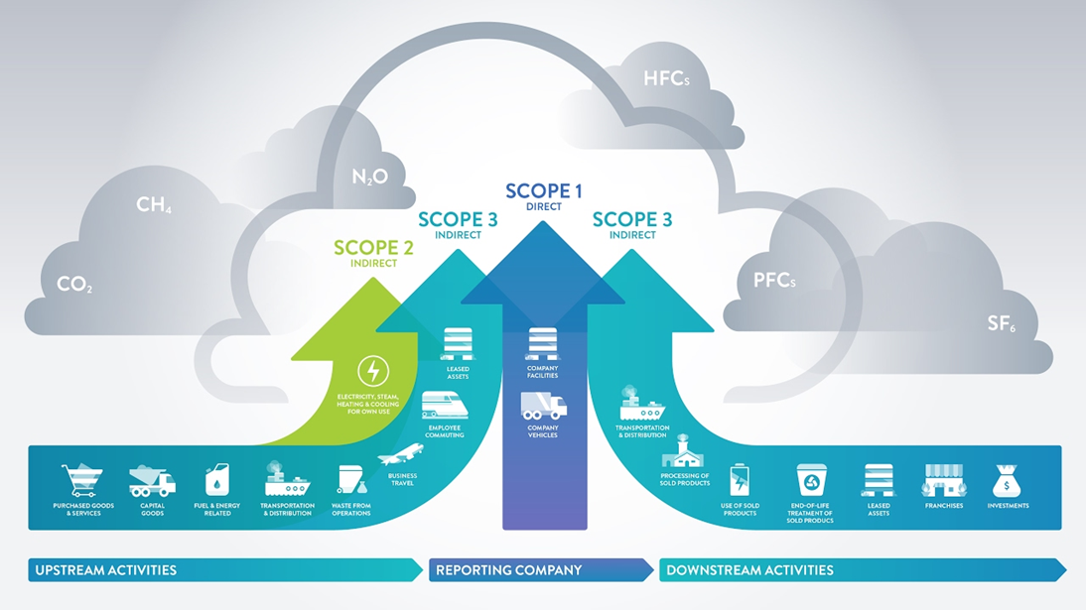
GHG emissions scopes

Slide 5
Scope 3 value chain emissions IAEG guidance
Upstream |  |  | Downstream
Emission Category | Relevance | Guidance Provided | Emission Category | Relevance | Guidance Provided
Purchased Goods & Services | Potentially Relevant | No | Downstream Transportation & Distribution | Potentially Relevant | Yes
Capital Goods | Potentially Relevant | No | Processing of Sold Products | Not Relevant | No
Energy and Fuel Related Activities | Not Relevant | No | Use of Sold Products | Relevant | No
Upstream Transportation & Distribution | Potentially Relevant | Yes | End of Life Treatment of Sold Products | Potentially Relevant | No
Waste Generated in Operations | Not Relevant | No | Downstream Leased Assets | Not Relevant | No
Business Travel | Potentially Relevant | Yes | Franchises | Not Relevant | No
Employee Commuting | Potentially Relevant | Yes | Investments | Not Relevant | No
Upstream Leased Assets | Not Relevant | No | Other | N/A | No
Notes:
PG&S, CG large material categories with significant impact to overall S3 inventory. Categories in yellow are outside the scope of articles of association of IAEG- no guidance provided.

Slide 6
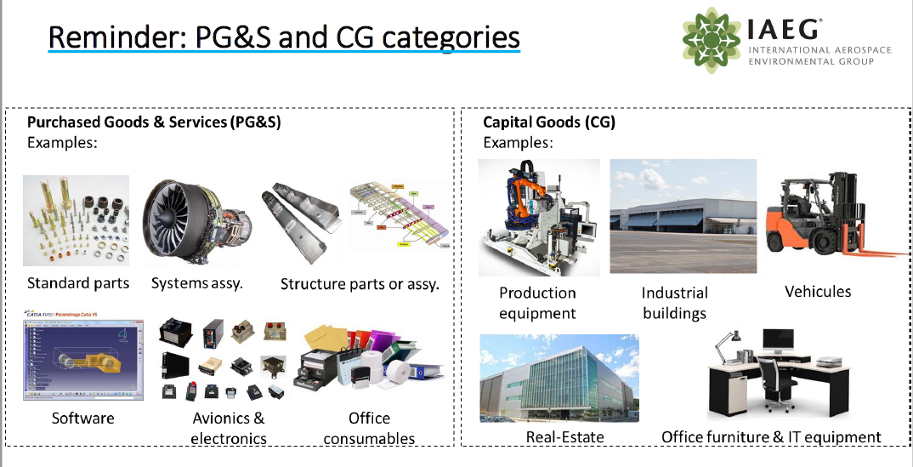
EXAMPLES OF PG&s AND cg CATEGORIES

Slide 7
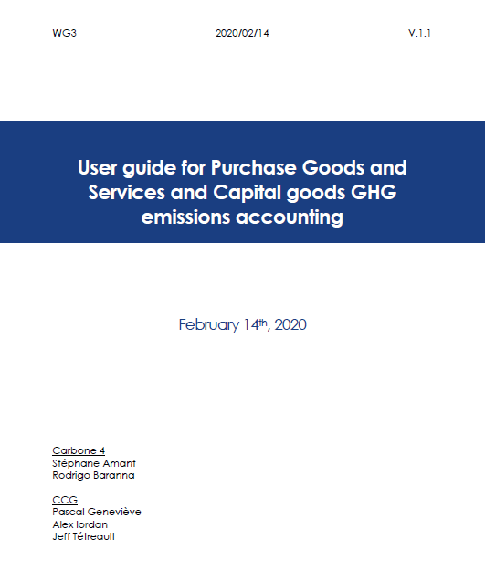
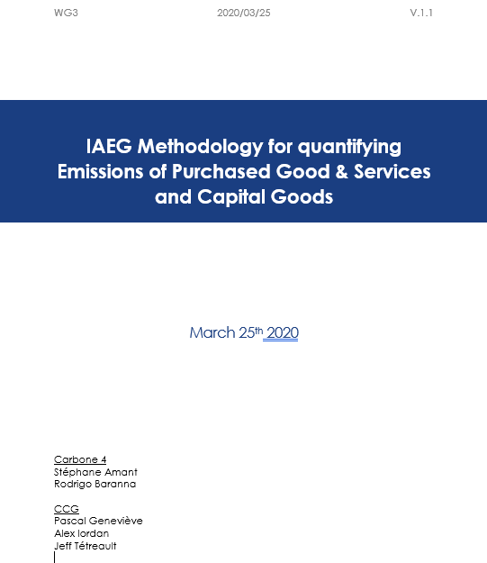
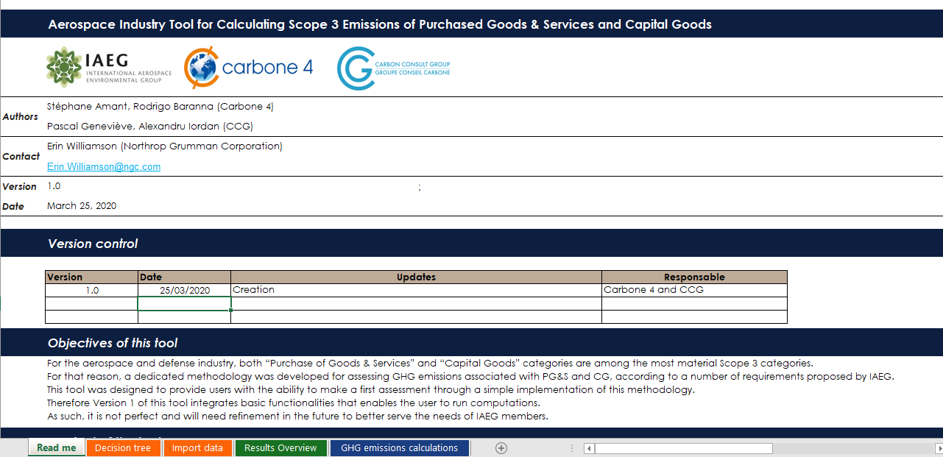
The deliverables
Calculation tool
User Guide
Methodology

Slide 8
Spend vs. mass methodology
Data Input Sources
Tool requires input for annual procurement in mass (kg) and/or spend ($/€)
Data should cover as close to 100% of annual procurement as possible
May require collaboration with Supply Chain function to map procurement categories to tool
Mass-based input data will result in more accurate output than spend-based due to emission factors
LCA
(outside scope of tool)
High
Mass-based
Inventory Accuracy
(output)
Hybrid
Spend-based
Low
Low
High
Data Precision
(input)

Slide 9
Sources of information for the tool
  Emission factor (EF) databases selection
    The following criteria were used to select the EF databases:
      Whenever possible, use public sources;
      Whenever possible, use cradle-to-gate EF;
      Databases updated within the last 5 years (where possible);
      Geographical scope: US, Europe, Japan, Brazil, or China;
      Environmentally Extended Input-Output (EEIO) tables for spend-based approach.
Database or Source | Type of EF | Geography | Last update | Source
DoD | Spend-based | USA | 2014 | DoD Sustainability Assessment Guidance - Appendix I Scoring Factors
EIO-LCA | Spend-based | USA | 2007 | Carnegie-Mellon University
USEEIO | Spend-based | USA | 2017 | US EPA
Base IMPACTS ® | Mass-based | Europe / World | 2018 | ADEME
Base Carbone ® | Spend-based and mass-based | France / Europe | 2019 | ADEME

Slide 10
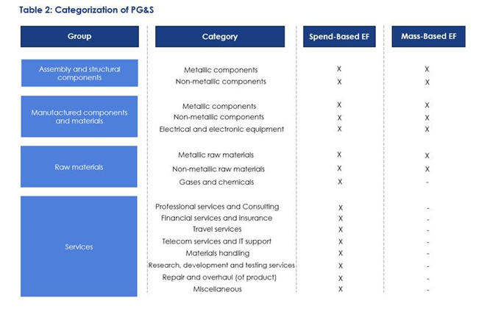
Groups, categories and emission factors
Notes:
The tool organizes groups of general product types purchased by aerospace companies, and associated categories within each group to allow users to simply select the spend based or mass based emission factors applicable to each Group/category/emission factor combination.
Purchased goods and services are classified into 16 categories relevant to the aerospace and defense industry value chain, organized into 4 general groups. The categories are the same across all 3 approaches of this methodology, but the granularity and type of EF in each category vary between approaches.

Slide 11
Tool demonstration

Slide 12
Benefits of the tool
  Applicability from entry level user to advanced user
    Spend based
    Hybrid
    Mass based
  Not a precise tool, but accurate enough to provide user with ability to determine how their inventory is apportioned across different categories of supply
  Provides user organisation with information to focus improvement activity
  Provides a consistent approach across the aerospace and defence industry
  Purchasing categories that are commonly used across aerospace and defence
  Can be partly customised for advanced users e.g. own emissions factors or purchasing categories
  Maintenance process so IAEC can update emissions factors annually without need for consultancy input
  User data retained with in their own firewalls
  Enable industry to respond to evolving carbon legislation and stakeholder expectation e.g. CDP, DJSI, EU Taxonomy Regulation, Science Based Targets

Slide 13
Tool testing and Pathway to approval
  Phase 1 pilot Nov 2019-Jan 2020 (WG3 User testing)
    User experience
    Functionality
    Comparability
  Phase 2 pilot (July 2020-Dec 2020) (Full IAEG membership)
    Provide introductory webinar (recorded and made available for IAEG members)
    Users test the tool for various functionality
    Collect feedback in survey and review
    Adjust tool as needed
  Seek WRI GHG Protocol Accreditation (early 2021)
  Seek IAEG full Board approval (April 2021)
  Annual maintenance process in place: WG3 will review the tool for updates to data sources and inputs before annual reporting cycle in accordance with documentation (ongoing)

Slide 14
Next steps (Through dec. 2020)
Review User Guide for steps to test tool
Document challenges, feedback, etc.
WG3 will send SurveyMonkey link to capture feedback
Questions can be directed to WG3: Erin.Williamson@ngc.com
Documents found on IAEG.com here:
  Clean Excel copy of tool
  User Guide
  Methodology

Slide 15
copyright
© 2020 IAEG® The International Aerospace Environmental Group® ("IAEG® ") is the owner of this material. This material may not be used for any purpose other than that for which it is provided without the express written consent of IAEG® . IAEG® will accept no liability either directly or indirectly for damages from any use of this material including without limitation any indirect, incidental, special and consequential damages, loss of data, income, profit or goodwill, loss of or damage to property or claims of third parties. IAEG® reserves the right to add to, change or delete its content or any part thereof without notice.

Slide 16
BACKUP

Slide 17
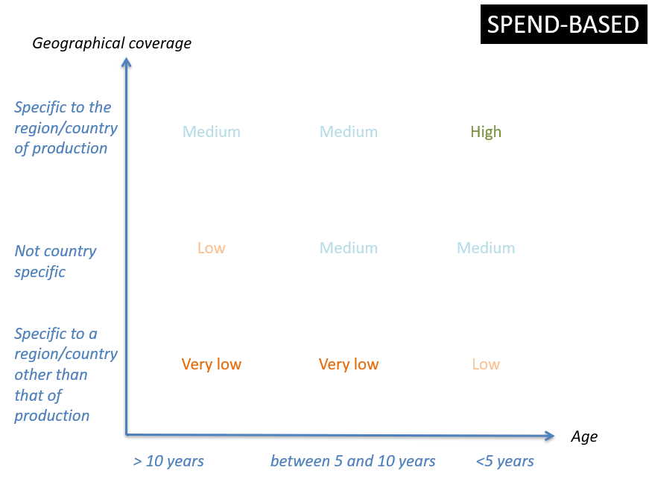
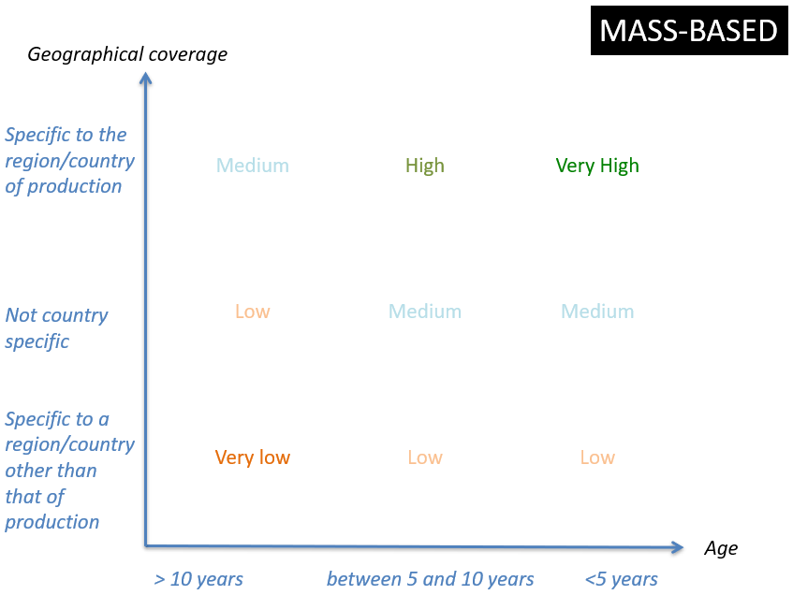
Overview of methodologies

Slide 19
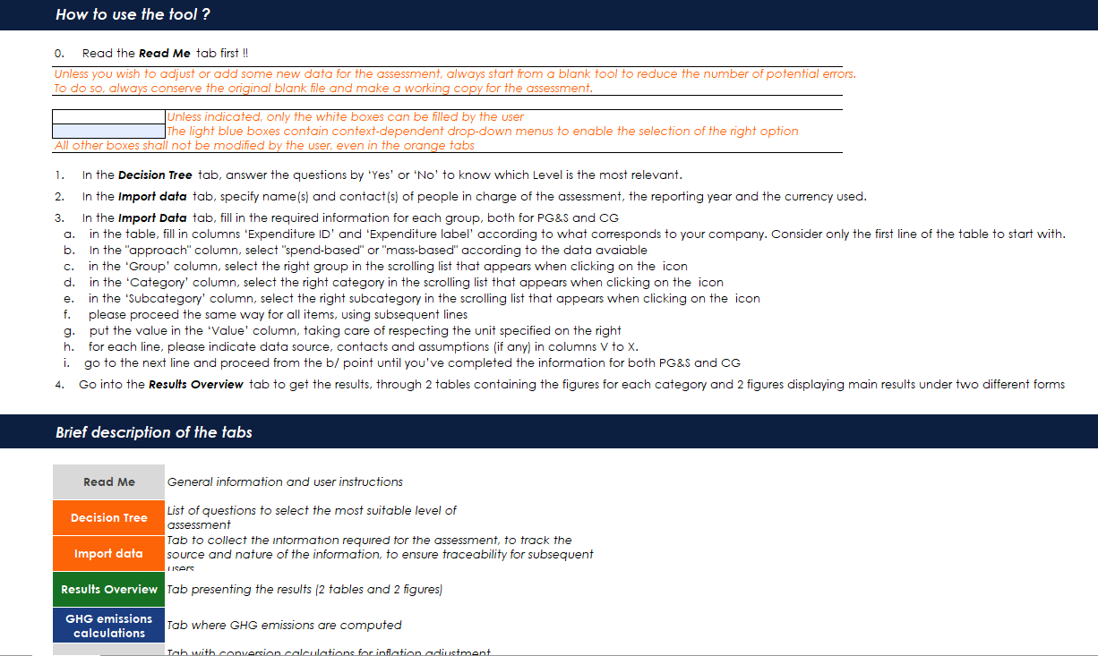
Tool screenshots: Read me tab

Slide 20
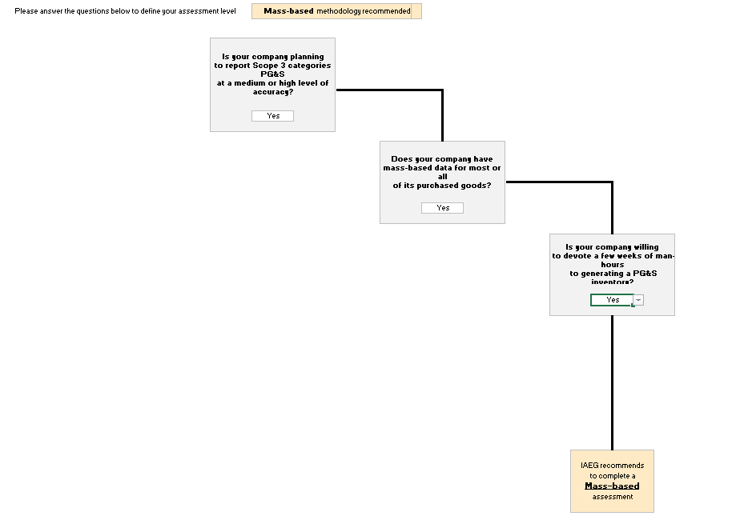
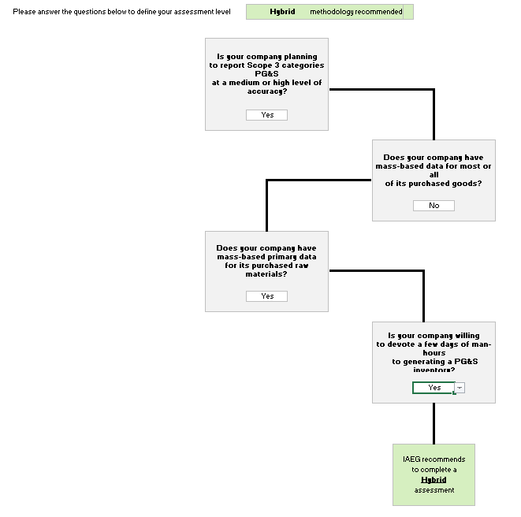
Tool screenshots: decision tree

Slide 21
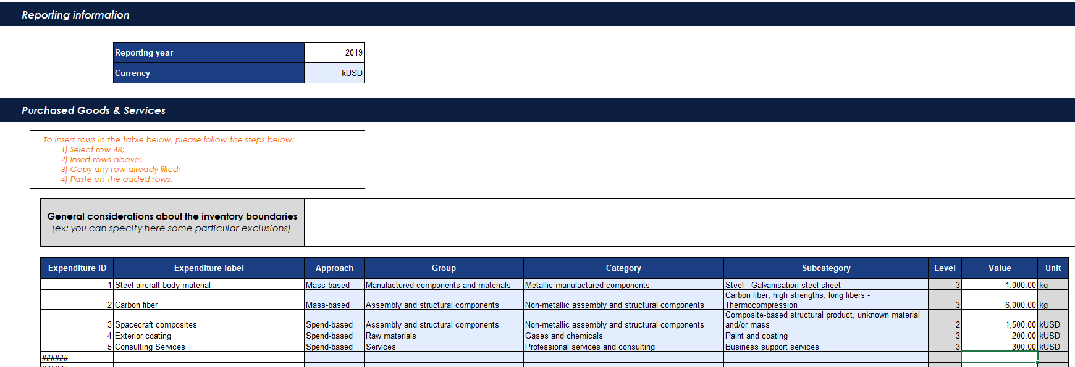
Tool screenshots: import data

Slide 22
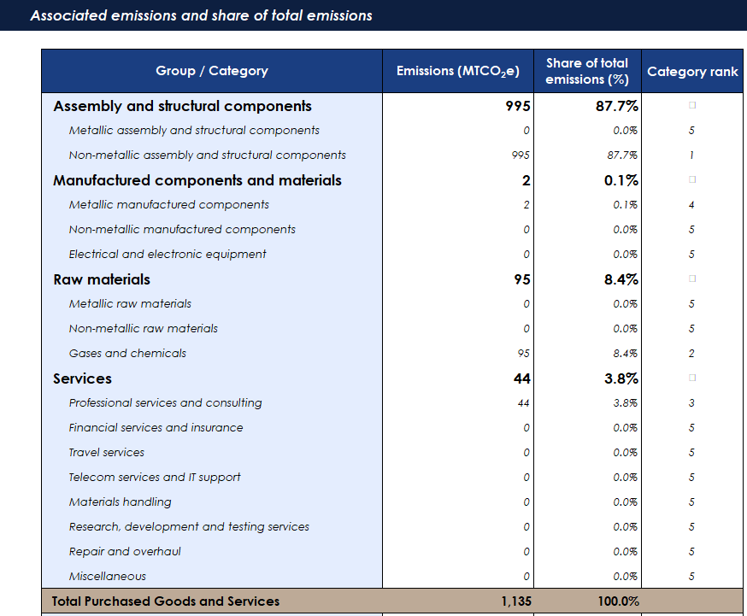
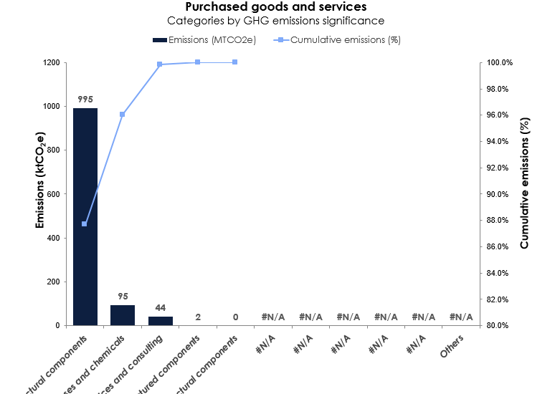
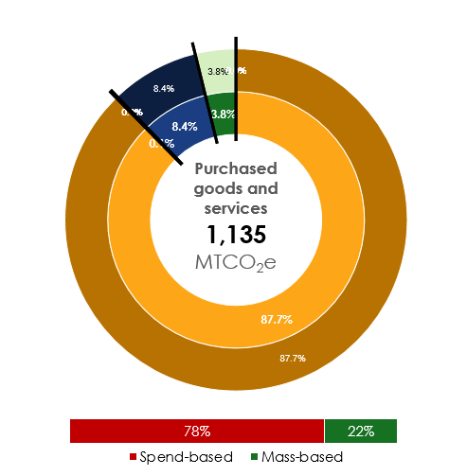
Tool screenshots: results overview

